Slide 1

Inventory Management
Chapter 16

Slide 2
Chapter Topics
Elements of Inventory Management
Inventory Control Systems
Economic Order Quantity Models
The Basic EOQ Model
The EOQ Model with Non-Instantaneous Receipt
The EOQ Model with Shortages
EOQ Analysis with QM for Windows
EOQ Analysis with Excel and Excel QM
Quantity Discounts
Reorder Point
Determining Safety Stocks Using Service Levels
Order Quantity for a Periodic Inventory System
Copyright © 2010 Pearson Education, Inc. Publishing as Prentice Hall

Slide 3
Elements of Inventory Management
Role of Inventory (1 of 2)
Inventory is a stock of items kept on hand used to meet customer demand..
A level of inventory is maintained that will meet anticipated demand.
If demand not known with certainty, safety (buffer) stocks are kept on hand.
Additional stocks are sometimes built up to meet seasonal or cyclical demand.
Large amounts of inventory sometimes purchased to take advantage of discounts.
Copyright © 2010 Pearson Education, Inc. Publishing as Prentice Hall

Slide 4
Elements of Inventory Management
Role of Inventory (2 of 2)
In-process inventories maintained to provide independence between operations.
Raw materials inventory kept to avoid delays in case of supplier problems.
Stock of finished parts kept to meet customer demand in event of work stoppage.
In general inventory serves to decouple consecutive steps.
Copyright © 2010 Pearson Education, Inc. Publishing as Prentice Hall

Slide 5
Elements of Inventory Management Demand
Inventory exists to meet the demand of customers.
Customers can be external (purchasers of products) or internal (workers using material).
Management needs an accurate forecast of demand.
Items that are used internally to produce a final product are referred to as dependent demand items.
Items that are final products demanded by an external customer are independent demand items.
Copyright © 2010 Pearson Education, Inc. Publishing as Prentice Hall

Slide 6
Elements of Inventory Management
Inventory Costs (1 of 3)
Carrying costs - Costs of holding items in storage.
  Vary with level of inventory and sometimes with length of time held.
  Include facility operating costs, record keeping, interest, etc.
  Assigned on a per unit basis per time period, or as percentage of average inventory value (usually estimated as 10% to 40%).
Copyright © 2010 Pearson Education, Inc. Publishing as Prentice Hall

Slide 7
Elements of Inventory Management
Inventory Costs (2 of 3)
Ordering costs - costs of replenishing stock of inventory.
  Expressed as dollar amount per order, independent of order size.
  Vary with the number of orders made.
  Include purchase orders, shipping, handling, inspection, etc.
Copyright © 2010 Pearson Education, Inc. Publishing as Prentice Hall

Slide 8
Elements of Inventory Management
Inventory Costs (3 of 3)
Shortage (stockout ) costs - Associated with insufficient inventory.
  Result in permanent loss of sales and profits for items not on hand.
  Sometimes penalties involved; if customer is internal, work delays could result.
Copyright © 2010 Pearson Education, Inc. Publishing as Prentice Hall

Slide 9
Inventory Control Systems
An inventory control system controls the level of inventory by determining how much (replenishment level) and when to order.
Two basic types of systems -continuous (fixed-order quantity) and periodic (fixed-time).
  In a continuous system, an order is placed for the same constant amount when inventory decreases to a specified level.
  In a periodic system, an order is placed for a variable amount after a specified period of time.
Copyright © 2010 Pearson Education, Inc. Publishing as Prentice Hall

Slide 10
Inventory Control Systems
Continuous Inventory Systems
A continual record of inventory level is maintained.
Whenever inventory decreases to a predetermined level, the reorder point, an order is placed for a fixed amount to replenish the stock.
The fixed amount is termed the economic order quantity, whose magnitude is set at a level that minimizes the total inventory carrying, ordering, and shortage costs.
Because of continual monitoring, management is always aware of status of inventory level and critical parts, but system is relatively expensive to maintain.
Copyright © 2010 Pearson Education, Inc. Publishing as Prentice Hall

Slide 11
Inventory Control Systems
Periodic Inventory Systems
Inventory on hand is counted at specific time intervals and an order placed that brings inventory up to a specified level.
Inventory not monitored between counts and system is therefore less costly to track and keep account of.
Results in less direct control by management and thus generally higher levels of inventory to guard against stockouts.
System requires a new order quantity each time an order is placed.
Used in smaller retail stores, drugstores, grocery stores and offices.
Copyright © 2010 Pearson Education, Inc. Publishing as Prentice Hall

Slide 12
Economic Order Quantity Models
Economic order quantity, or economic lot size, is the quantity ordered when inventory decreases to the reorder point.
Amount is determined using the economic order quantity (EOQ) model.
Purpose of the EOQ model is to determine the optimal order size that will minimize total inventory costs.
Three model versions to be discussed:
  Basic EOQ model
  EOQ model without instantaneous receipt
  EOQ model with shortages
Copyright © 2010 Pearson Education, Inc. Publishing as Prentice Hall

Slide 13
Economic Order Quantity Models
Basic EOQ Model (1 of 2)
A formula for determining the optimal order size that minimizes the sum of carrying costs and ordering costs.
Simplifying assumptions and restrictions:
  Demand is known with certainty and is relatively constant over time.
  No shortages are allowed.
  Lead time for the receipt of orders is constant.
  The order quantity is received all at once and instantaneously.
Copyright © 2010 Pearson Education, Inc. Publishing as Prentice Hall

Slide 14
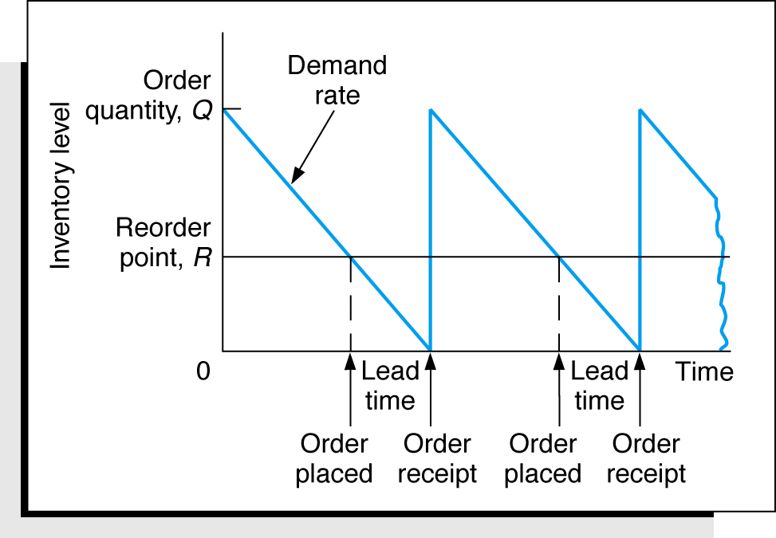
Economic Order Quantity Models
Basic EOQ Model (2 of 2)
Figure 16.1 The Inventory Order Cycle
Copyright © 2010 Pearson Education, Inc. Publishing as Prentice Hall

Slide 15
Basic EOQ Model
Carrying Cost (1 of 2)
Carrying cost usually expressed on a per unit basis of time, traditionally one year.
Annual carrying cost equals carrying cost per unit per year times average inventory level:
  Carrying cost per unit per year = C_{c}
  Average inventory = Q/2
  Annual carrying cost = C_{c}Q/2.
Copyright © 2010 Pearson Education, Inc. Publishing as Prentice Hall

Slide 16
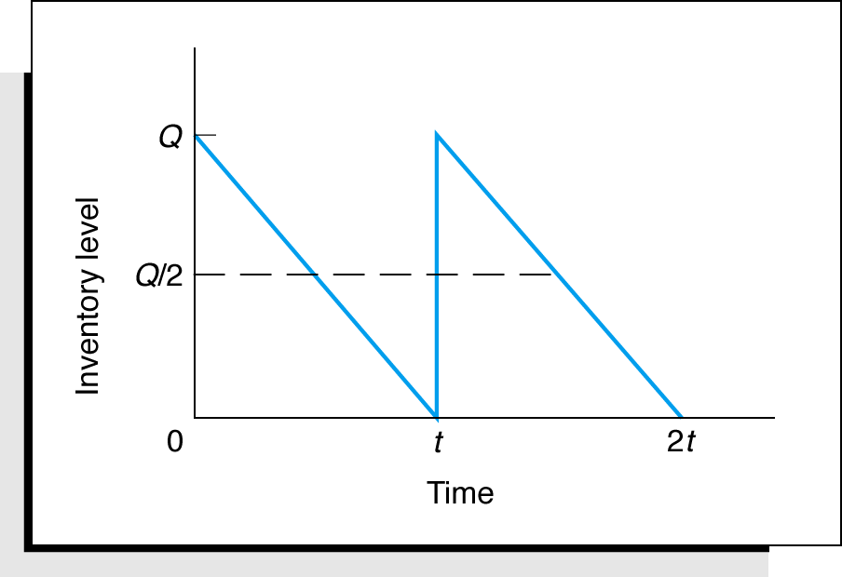
Basic EOQ Model
Carrying Cost (2 of 2)
Figure 16.4 Average Inventory
Copyright © 2010 Pearson Education, Inc. Publishing as Prentice Hall

Slide 17
Basic EOQ Model
Ordering Cost
Total annual ordering cost equals cost per order (C_{o}) times number of orders per year.
Number of orders per year, with known and constant demand, D, is D/Q, where Q is the order size:
  Annual ordering cost = C_{o}D/Q
  Only variable is Q, C_{o} and D are constant parameters.
Relative magnitude of the ordering cost is dependent on order size.
Copyright © 2010 Pearson Education, Inc. Publishing as Prentice Hall

Slide 18
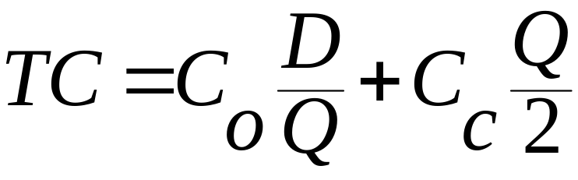
Basic EOQ Model
Total Inventory Cost (1 of 2)
Total annual inventory cost is sum of ordering and carrying cost:
Copyright © 2010 Pearson Education, Inc. Publishing as Prentice Hall

Slide 19
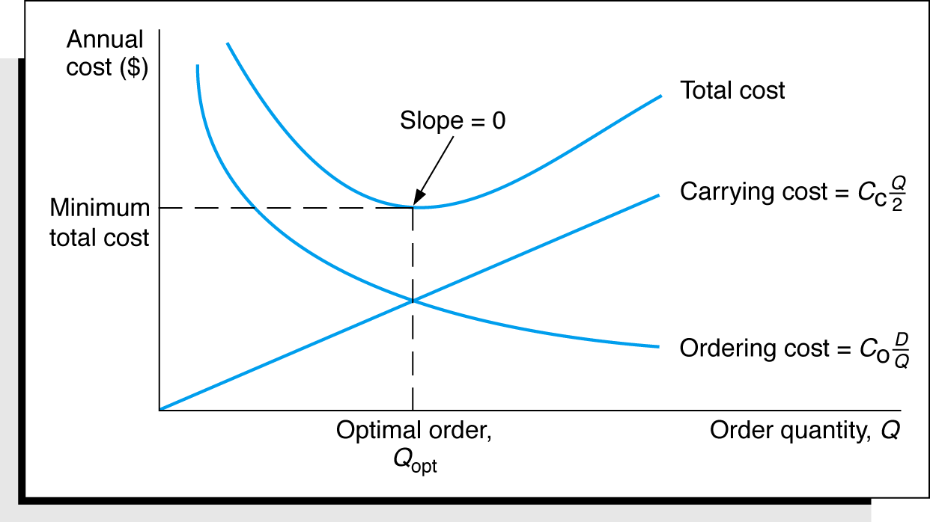
Basic EOQ Model
Total Inventory Cost (2 of 2)
Figure 16.5 The EOQ Cost Model
Copyright © 2010 Pearson Education, Inc. Publishing as Prentice Hall

Slide 20
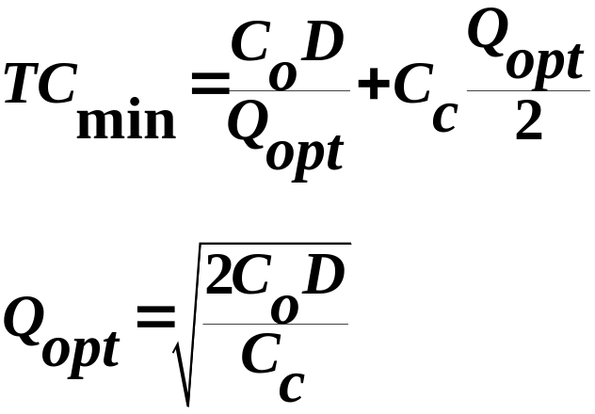
Basic EOQ Model
EOQ and Minimum Total Cost
EOQ occurs where total cost curve is at minimum value and carrying cost equals ordering cost:
The EOQ model is robust because Q is a square root and errors in the estimation of D, C_{c} and C_{o} are dampened.
Copyright © 2010 Pearson Education, Inc. Publishing as Prentice Hall

Slide 21
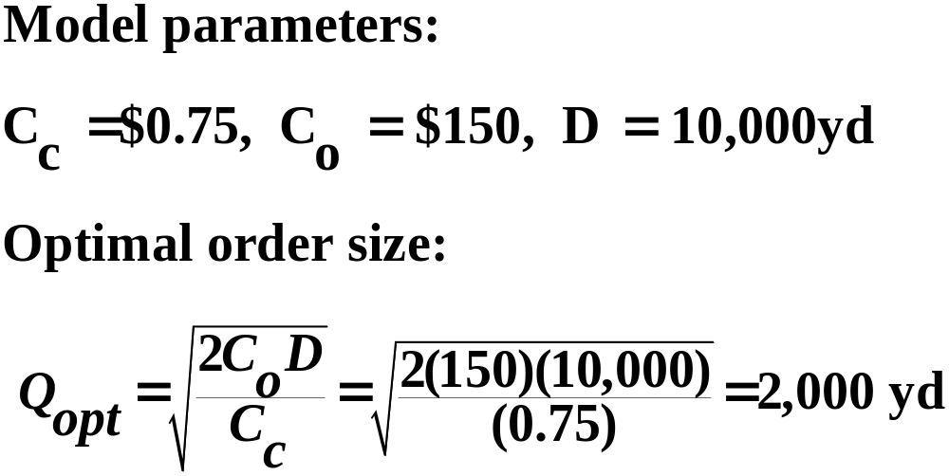
Basic EOQ Model
Example (1 of 2)
I-75 Carpet Discount Store, Super Shag carpet sales.
Given following data, determine number of orders to be made annually and time between orders given store is open every day except Sunday, Thanksgiving Day, and Christmas Day.
Copyright © 2010 Pearson Education, Inc. Publishing as Prentice Hall

Slide 22
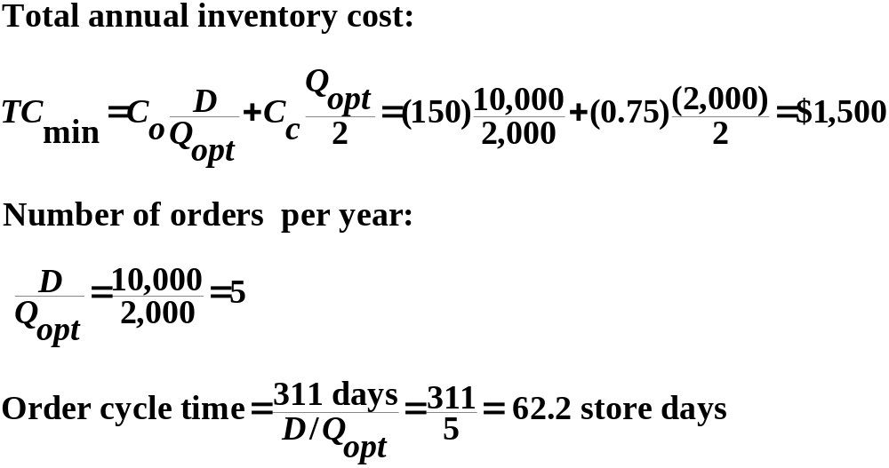
Basic EOQ Model
Example (2 of 2)
Copyright © 2010 Pearson Education, Inc. Publishing as Prentice Hall

Slide 23
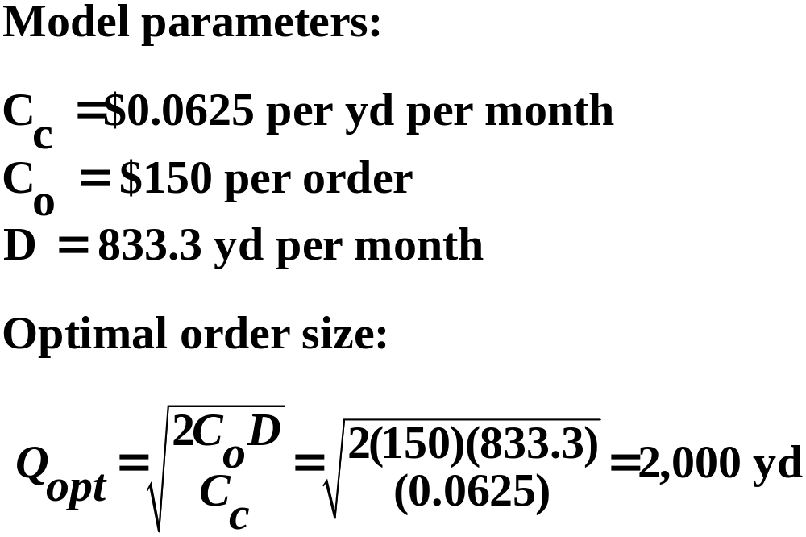
Basic EOQ Model
EOQ Analysis Over Time (1 of 2)
For any time period unit of analysis, EOQ is the same.
Shag Carpet example on monthly basis:
Copyright © 2010 Pearson Education, Inc. Publishing as Prentice Hall

Slide 24
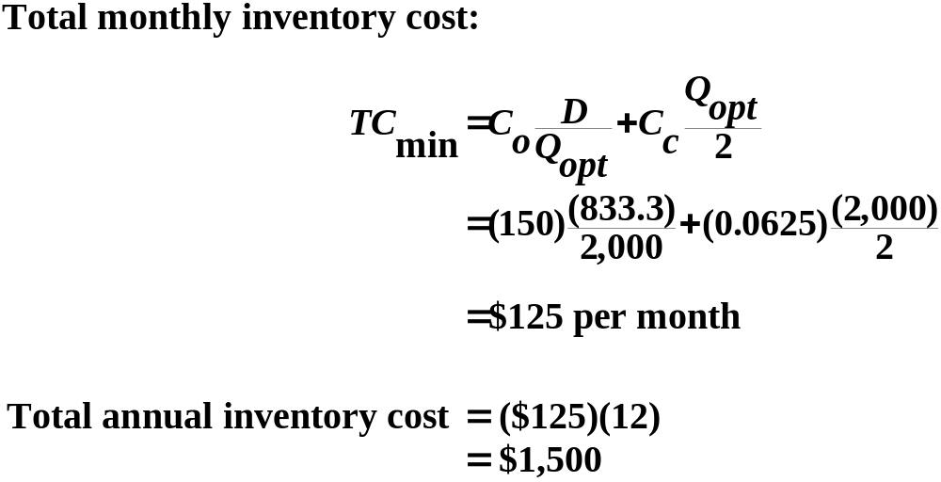
Basic EOQ Model
EOQ Analysis Over Time (2 of 2)
Copyright © 2010 Pearson Education, Inc. Publishing as Prentice Hall

Slide 25
EOQ Model
Non-Instantaneous Receipt Description (1 of 2)
In the non-instantaneous receipt model the assumption that orders are received all at once is relaxed. (Also known as gradual usage or production lot size model.)
The order quantity is received gradually over time and inventory is drawn on at the same time it is being replenished.
Copyright © 2010 Pearson Education, Inc. Publishing as Prentice Hall

Slide 26
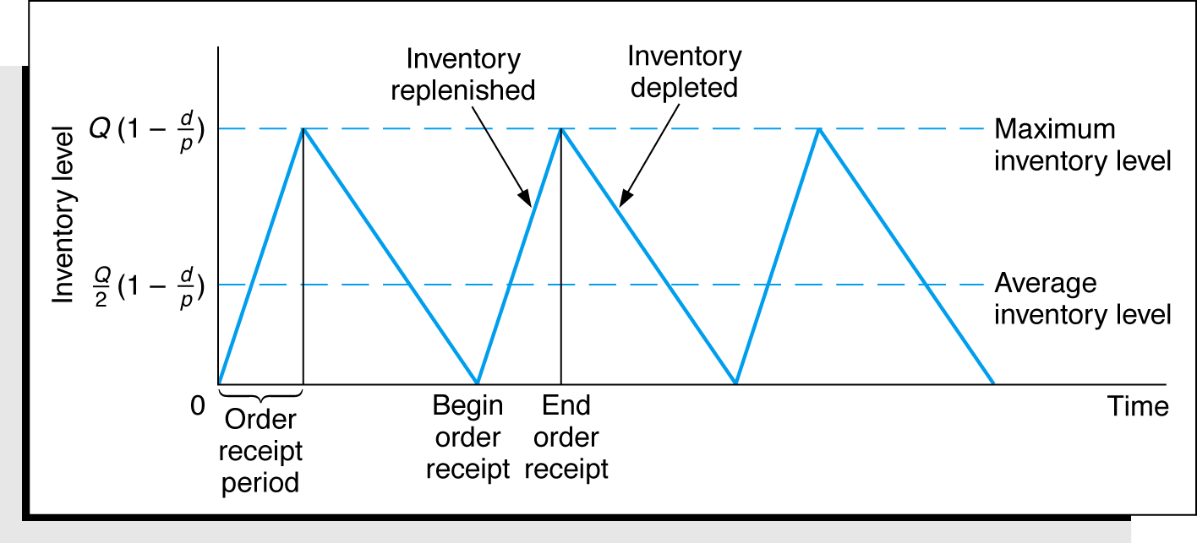
EOQ Model
Non-Instantaneous Receipt Description (2 of 2)
Figure 16.6 The EOQ Model with Non-Instantaneous Order Receipt
Copyright © 2010 Pearson Education, Inc. Publishing as Prentice Hall

Slide 27
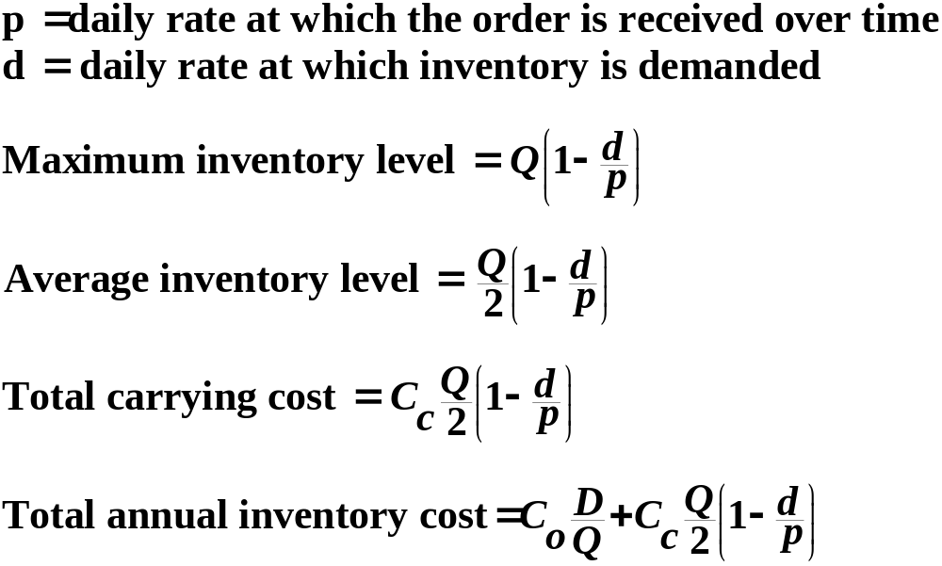
Non-Instantaneous Receipt Model
Model Formulation (1 of 2)
Copyright © 2010 Pearson Education, Inc. Publishing as Prentice Hall

Slide 28
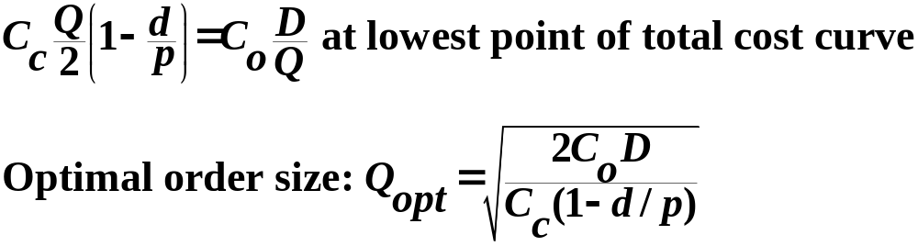
Non-Instantaneous Receipt Model
Model Formulation (2 of 2)
Copyright © 2010 Pearson Education, Inc. Publishing as Prentice Hall

Slide 29
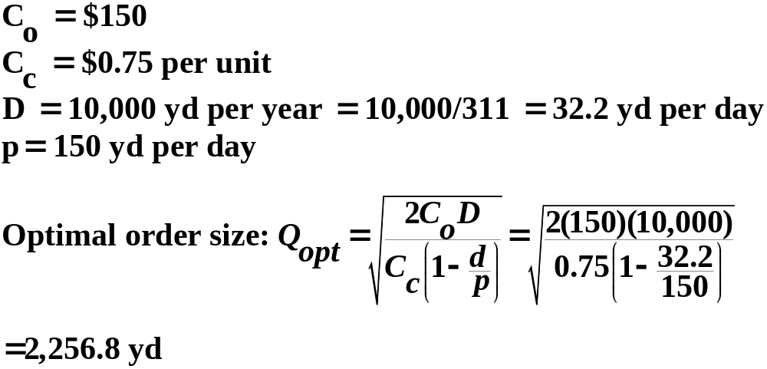
Non-Instantaneous Receipt Model
Example (1 of 2)
Super Shag carpet manufacturing facility:
Copyright © 2010 Pearson Education, Inc. Publishing as Prentice Hall

Slide 30
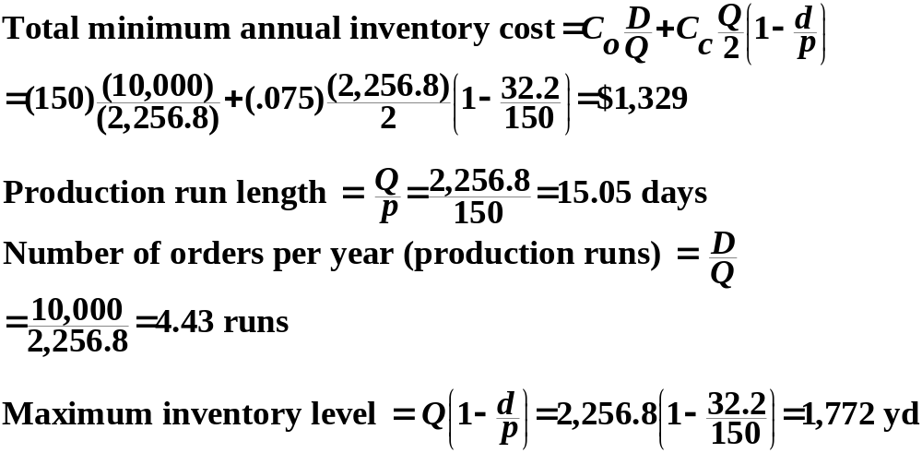
Non-Instantaneous Receipt Model
Example (2 of 2)
Copyright © 2010 Pearson Education, Inc. Publishing as Prentice Hall

Slide 31
EOQ Model with Shortages
Description (1 of 2)
In the EOQ model with shortages, the assumption that shortages cannot exist is relaxed.
Assumed that unmet demand can be backordered with all demand eventually satisfied.
Copyright © 2010 Pearson Education, Inc. Publishing as Prentice Hall

Slide 32
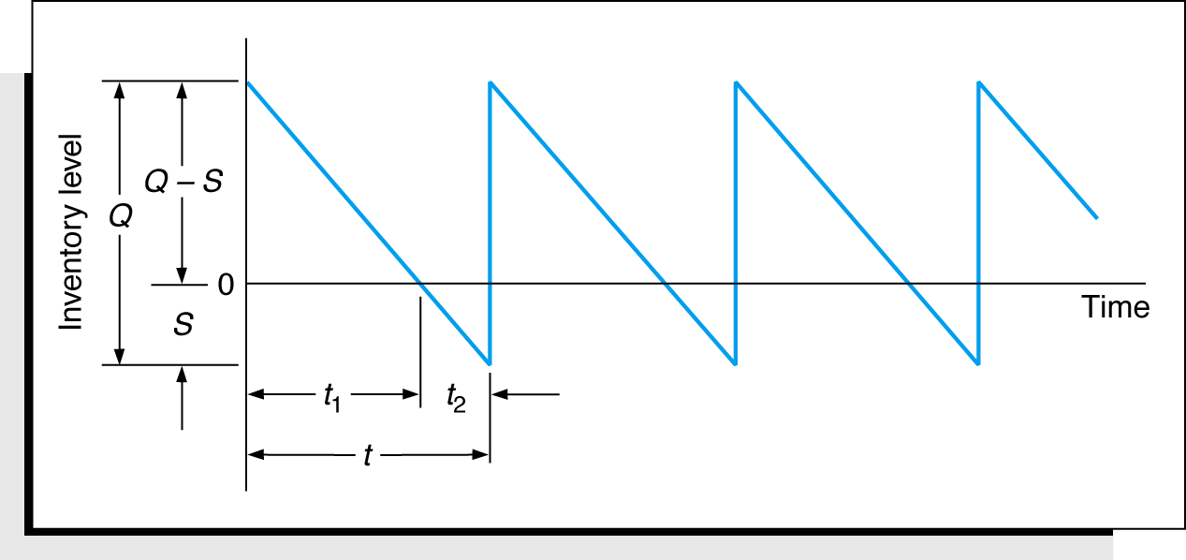
EOQ Model with Shortages
Description (2 of 2)
Figure 16.7 The EOQ Model with Shortages
Copyright © 2010 Pearson Education, Inc. Publishing as Prentice Hall

Slide 33
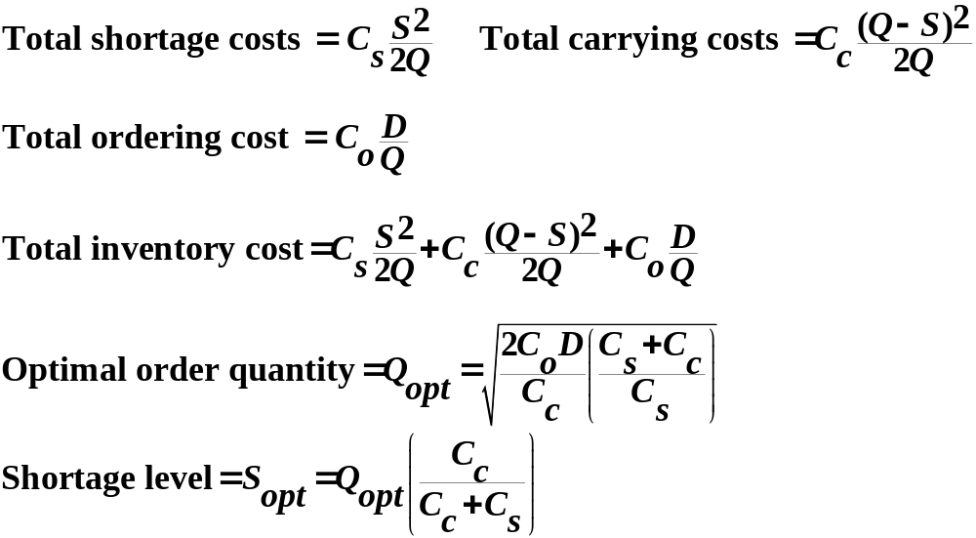
EOQ Model with Shortages
Model Formulation (1 of 2)
Copyright © 2010 Pearson Education, Inc. Publishing as Prentice Hall

Slide 34
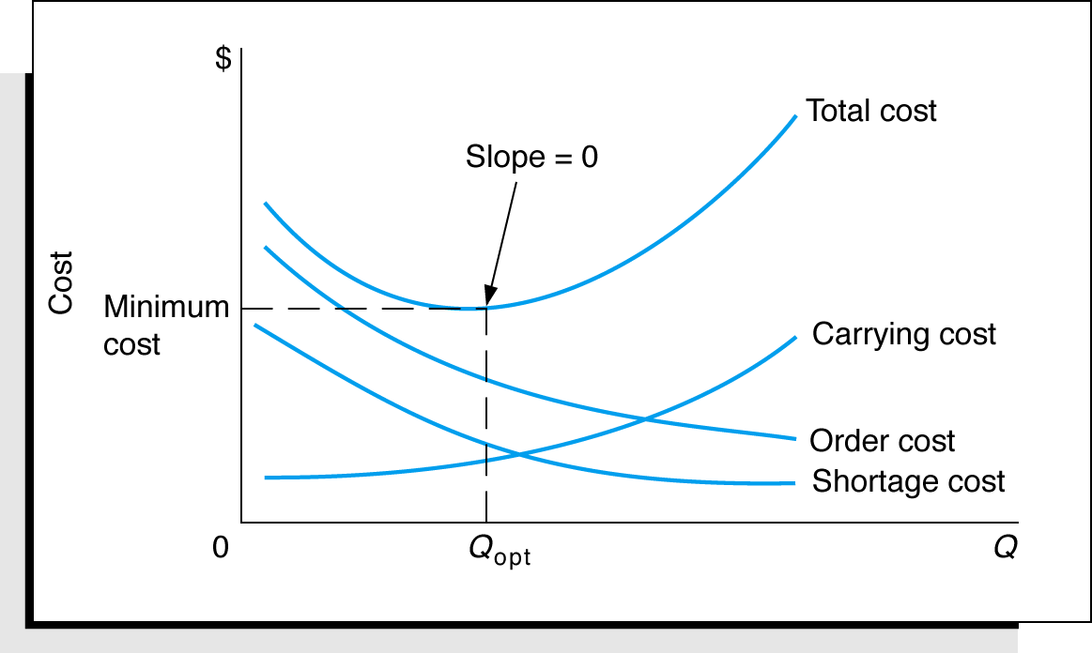
EOQ Model with Shortages
Model Formulation (2 of 2)
Figure 16.8 Cost Model with Shortages
Copyright © 2010 Pearson Education, Inc. Publishing as Prentice Hall

Slide 35
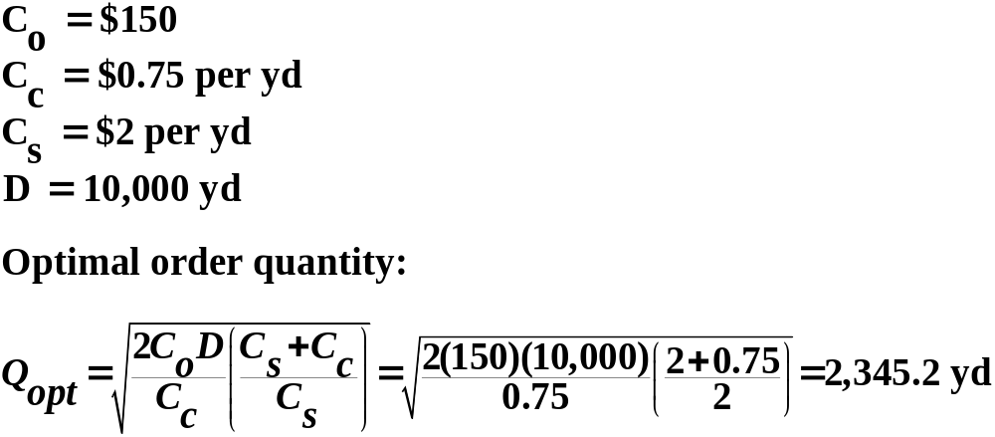
EOQ Model with Shortages
Model Formulation (1 of 3)
I-75 Carpet Discount Store allows shortages; shortage cost C_{s,} is $2/yard per year.
Copyright © 2010 Pearson Education, Inc. Publishing as Prentice Hall

Slide 36
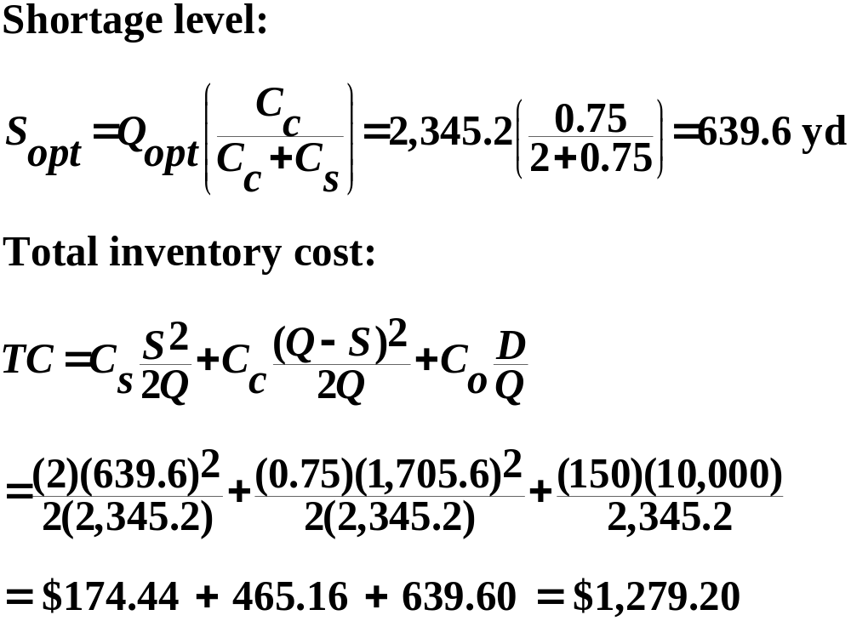
EOQ Model with Shortages
Model Formulation (2 of 3)
Copyright © 2010 Pearson Education, Inc. Publishing as Prentice Hall

Slide 37
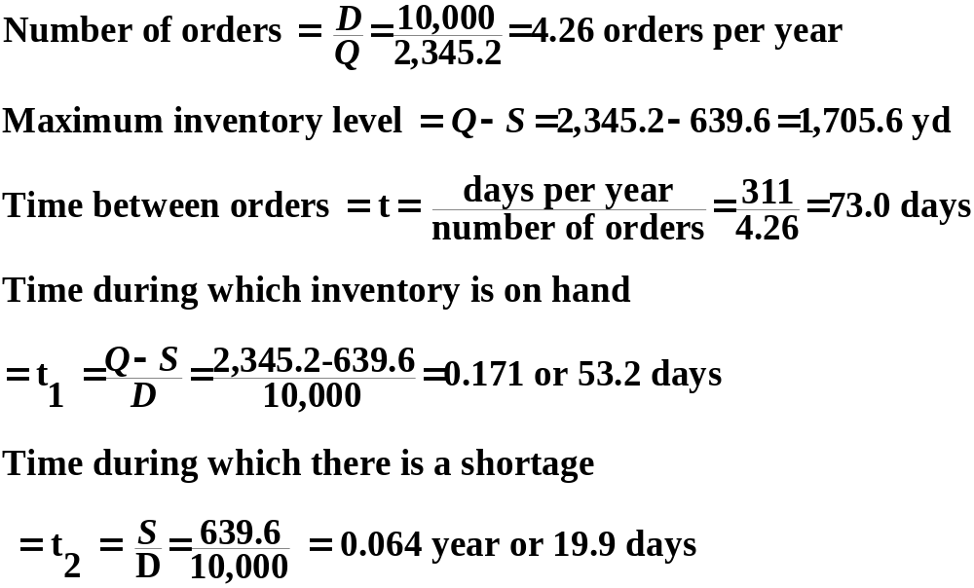
EOQ Model with Shortages
Model Formulation (3 of 3)
Copyright © 2010 Pearson Education, Inc. Publishing as Prentice Hall

Slide 38
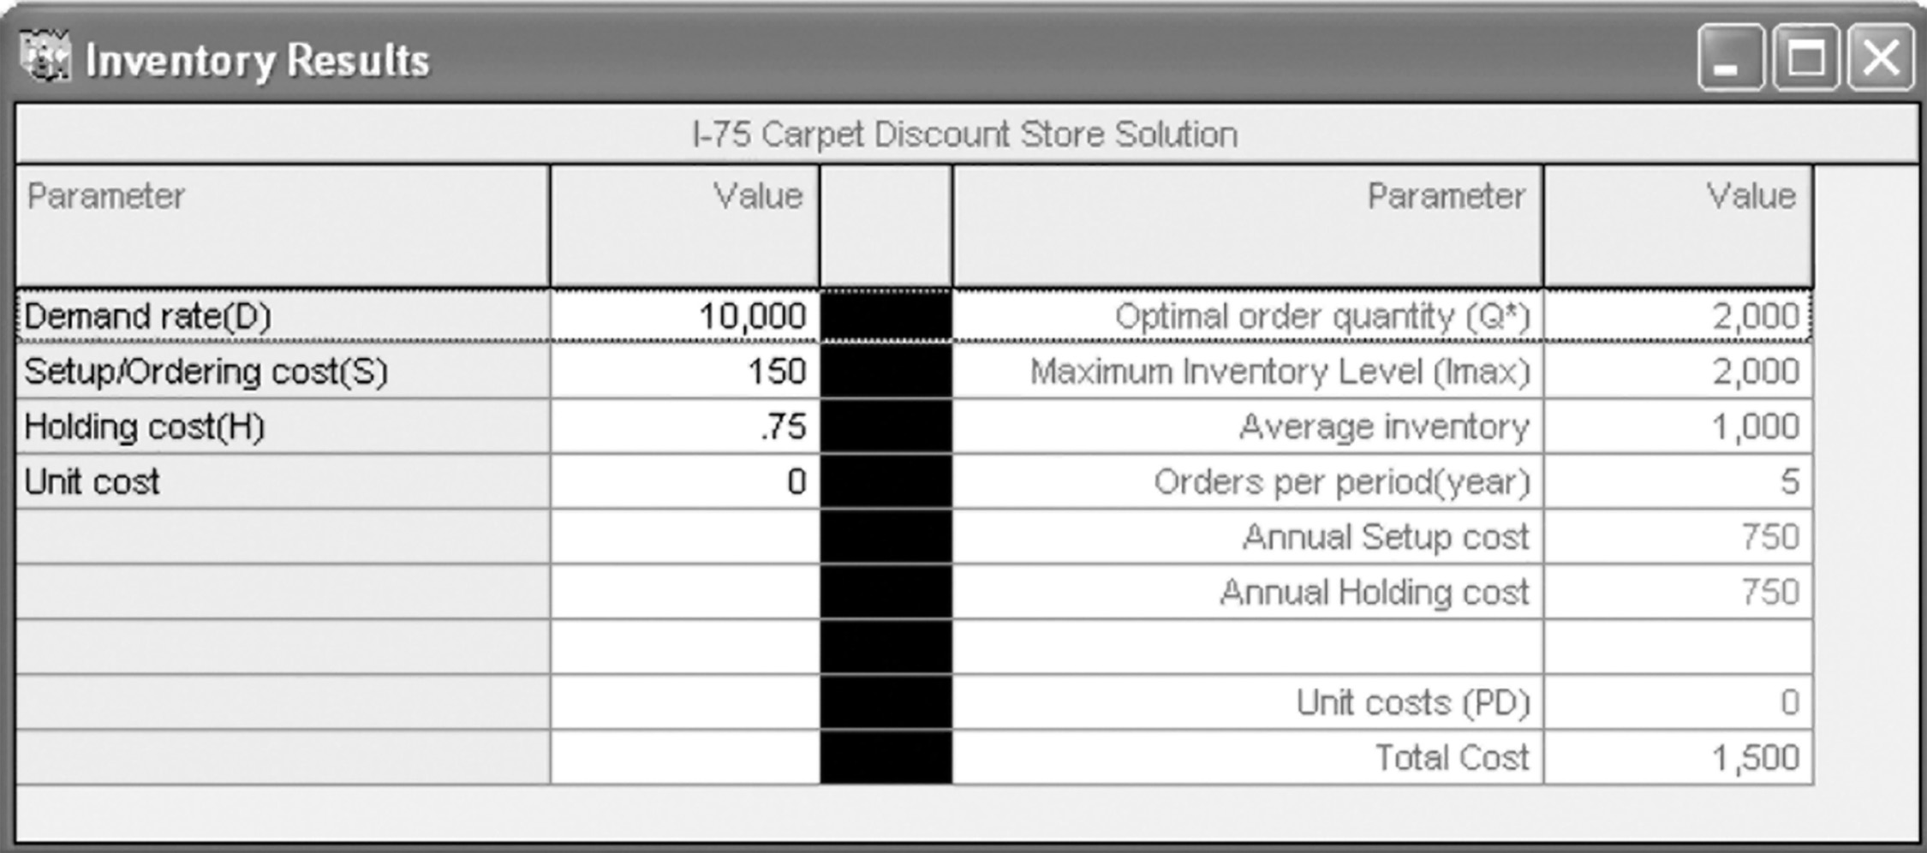
EOQ Analysis with QM for Windows
Exhibit 16.1

Slide 39
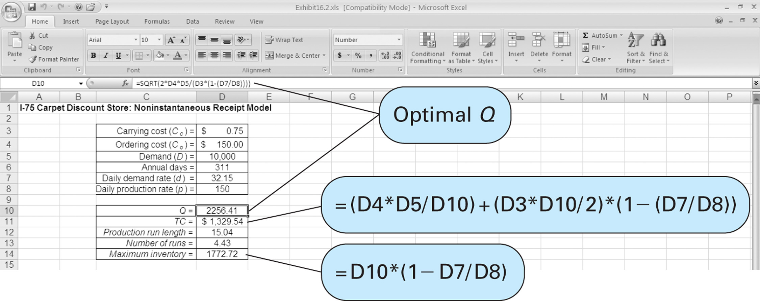
EOQ Analysis with Excel and Excel QM (1 of 2)
Exhibit 16.2
Copyright © 2010 Pearson Education, Inc. Publishing as Prentice Hall

Slide 40
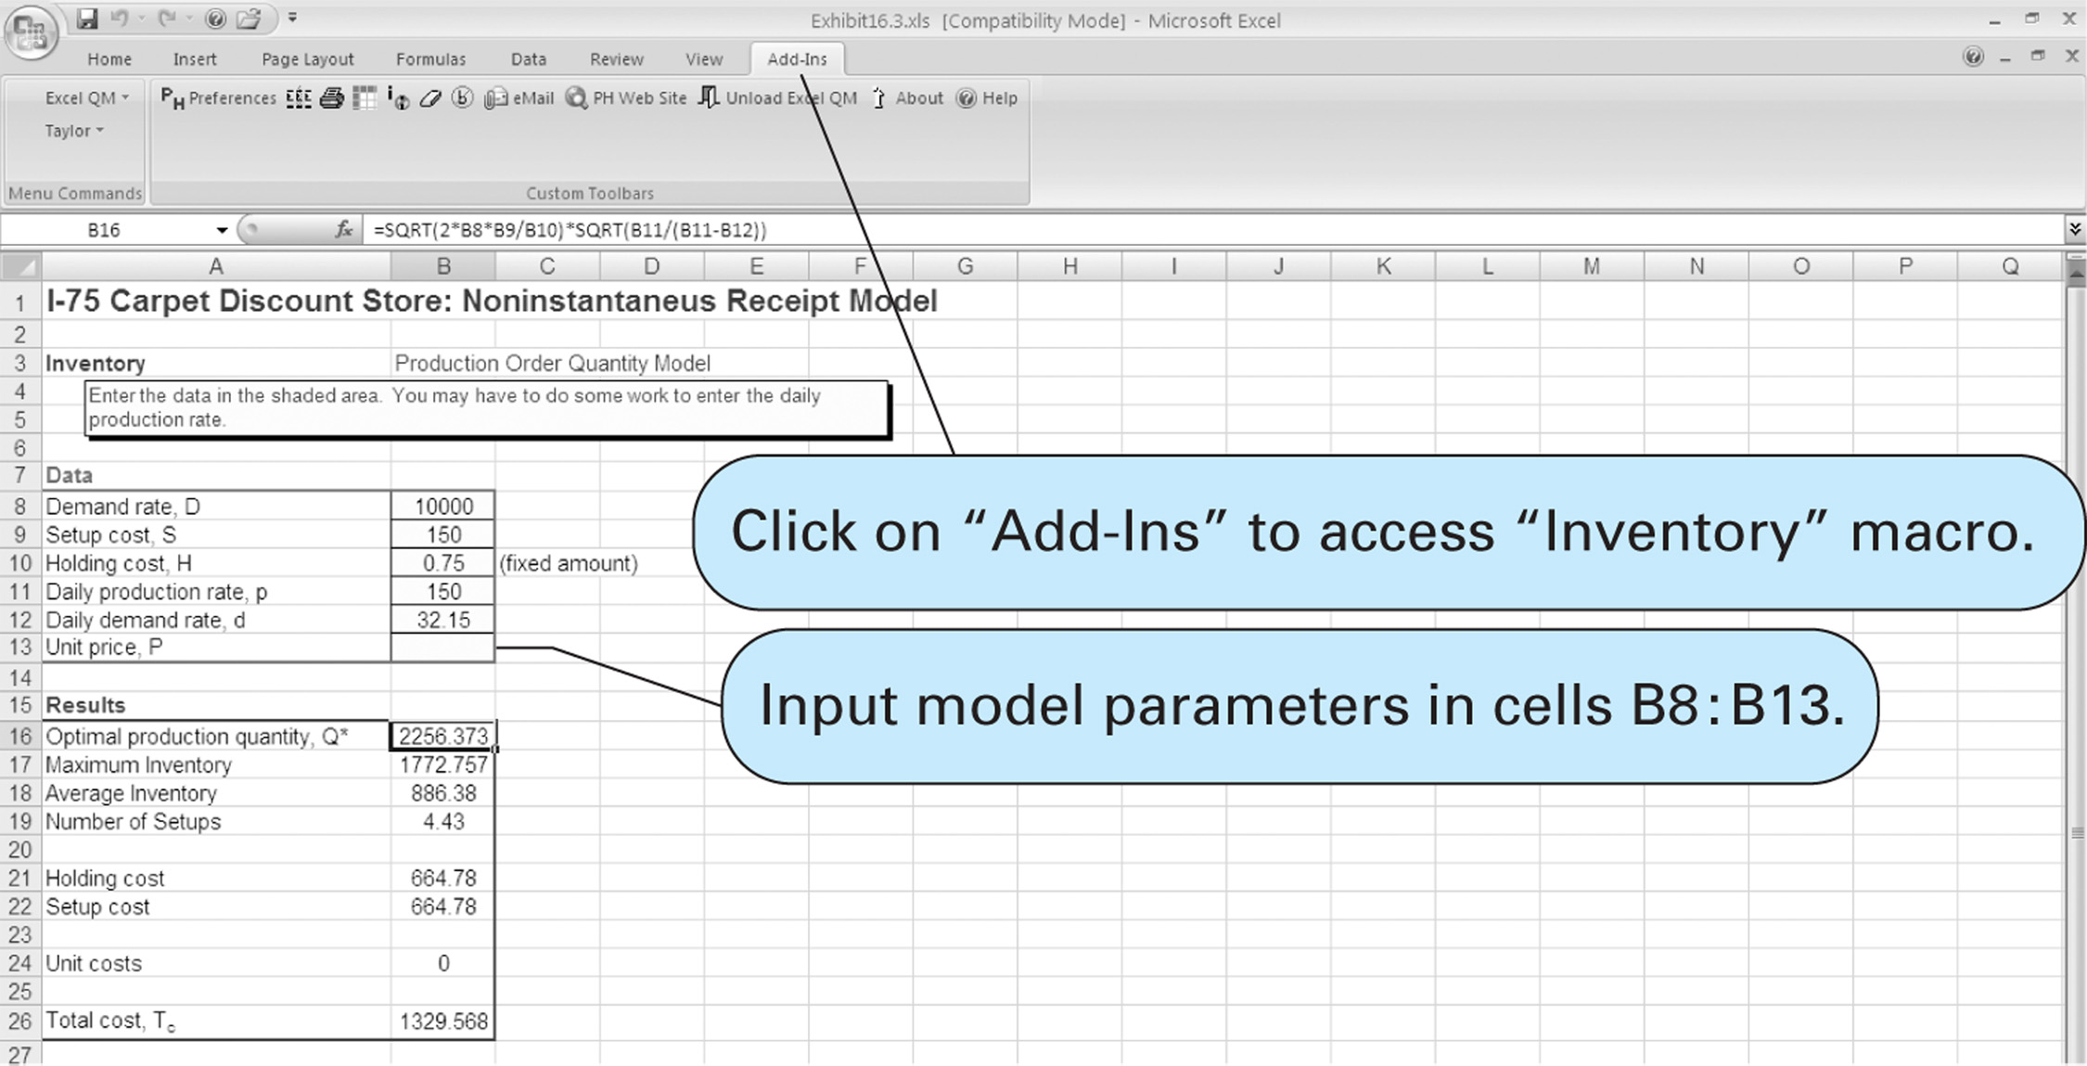
EOQ Analysis with Excel and Excel QM (2 of 2)
Copyright © 2010 Pearson Education, Inc. Publishing as Prentice Hall
Exhibit 16.3

Slide 41
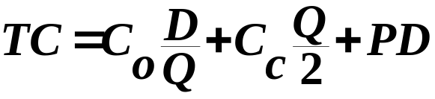
Quantity Discounts
Price discounts are often offered if a predetermined number of units is ordered or when ordering materials in high volume.
Basic EOQ model used with purchase price added:
where: P = per unit price of the item
D = annual demand
Quantity discounts are evaluated under two different scenarios:
  With constant carrying costs
  With carrying costs as a percentage of purchase price
Copyright © 2010 Pearson Education, Inc. Publishing as Prentice Hall

Slide 42
Quantity Discounts with Constant Carrying Costs Analysis Approach
Optimal order size is the same regardless of the discount price.
The total cost with the optimal order size must be compared with any lower total cost with a discount price to determine which is the lesser.
Copyright © 2010 Pearson Education, Inc. Publishing as Prentice Hall

Slide 43
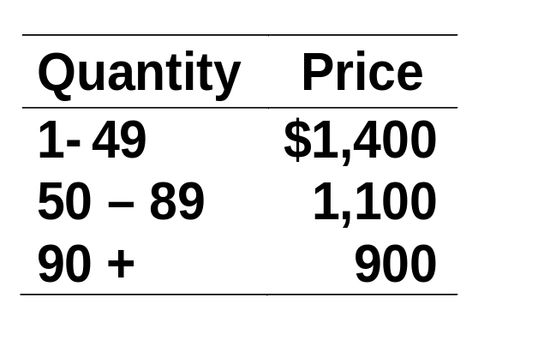
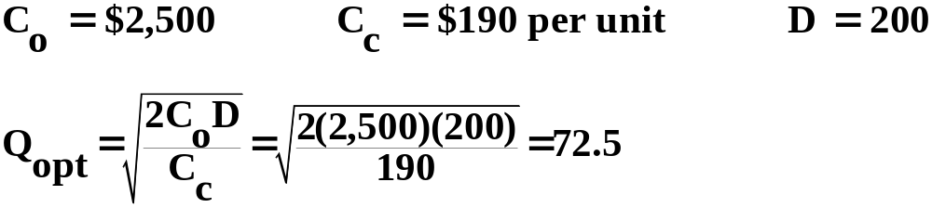
Quantity Discounts with Constant Carrying Costs
Example (1 of 2)
University bookstore: For following discount schedule offered by Comptek, should bookstore buy at the discount terms or order the basic EOQ order size?
Determine optimal order size and total cost:
Copyright © 2010 Pearson Education, Inc. Publishing as Prentice Hall

Slide 44
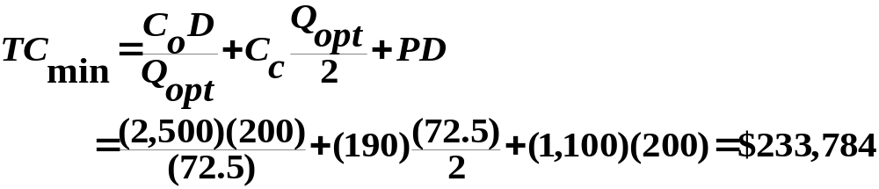
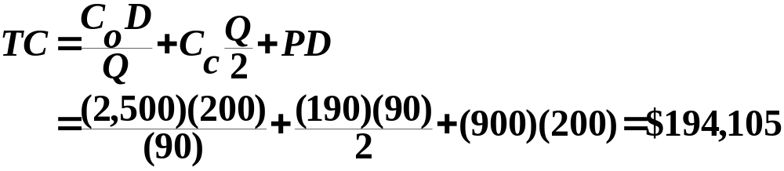
Quantity Discounts with Constant Carrying Costs
Example (2 of 2)
Compute total cost at eligible discount price ($1,100):
Compare with total cost of with order size of 90 and price of $900:
Because $194,105 < $233,784, maximum discount price should be taken and 90 units ordered.
Copyright © 2010 Pearson Education, Inc. Publishing as Prentice Hall

Slide 45
Quantity Discounts with Carrying Costs
Percentage of Price Example (1 of 3)
University Bookstore example, but a different optimal order size for each price discount.
Optimal order size and total cost determined using basic EOQ model with no quantity discount.
This cost then compared with various discount quantity order sizes to determine minimum cost order.
This must be compared with EOQ-determined order size for specific discount price.
Data:
  C_{o} = $2,500
  D = 200 computers per year
Copyright © 2010 Pearson Education, Inc. Publishing as Prentice Hall

Slide 46
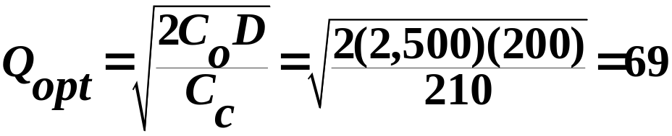
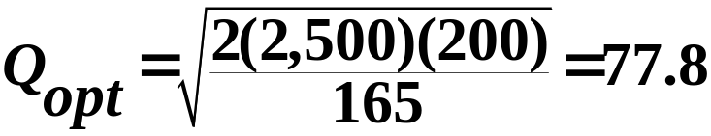
Quantity Discounts with Carrying Costs
Percentage of Price Example (2 of 3)
Compute optimum order size for purchase price without discount and C_{c} = $210:
Compute new order size:
Quantity Price Carrying Cost
0 - 49 $1,400 1,400(.15) = $210
50 - 89 1,100 1,100(.15) = 165
90 + 900 900(.15) = 135
Copyright © 2010 Pearson Education, Inc. Publishing as Prentice Hall

Slide 47
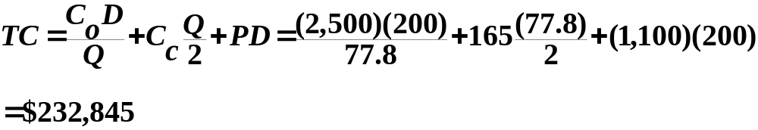
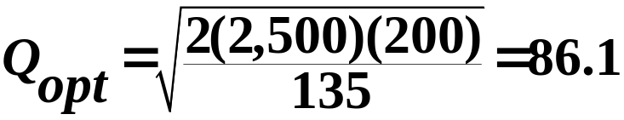
Quantity Discounts with Carrying Costs
Percentage of Price Example (3 of 3)
Compute minimum total cost:
Compare with cost, discount price of $900, order quantity of 90:
Optimal order size computed as follows:
Since this order size is less than 90 units , it is not feasible, thus optimal order size is 90 units.
Copyright © 2010 Pearson Education, Inc. Publishing as Prentice Hall

Slide 48
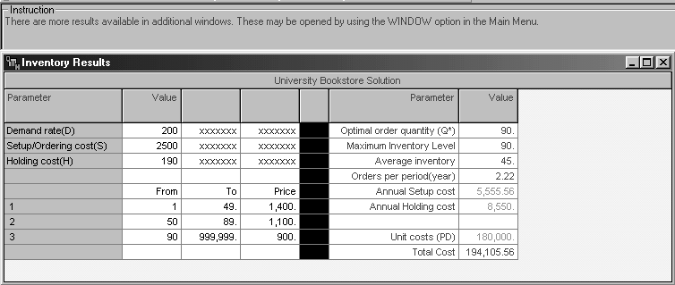
Quantity Discount Model
Solution with QM for Windows
Exhibit 16.4
Copyright © 2010 Pearson Education, Inc. Publishing as Prentice Hall

Slide 49
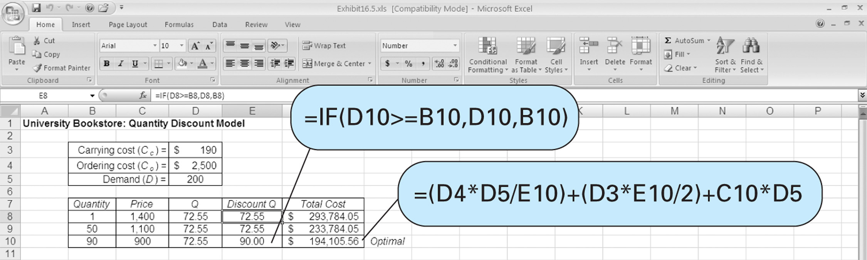
Quantity Discount Model
Solution with QM for Windows
Exhibit 16.5
Copyright © 2010 Pearson Education, Inc. Publishing as Prentice Hall

Slide 50
Reorder Point (1 of 4)
The reorder point is the inventory level at which a new order is placed.
Order must be made while there is enough stock in place to cover demand during lead time.
Formulation:
  R = dL
  where d = demand rate per time period
  L = lead time
For Carpet Discount store problem:
R = dL = (10,000/311)(10) = 321.54
Copyright © 2010 Pearson Education, Inc. Publishing as Prentice Hall

Slide 51
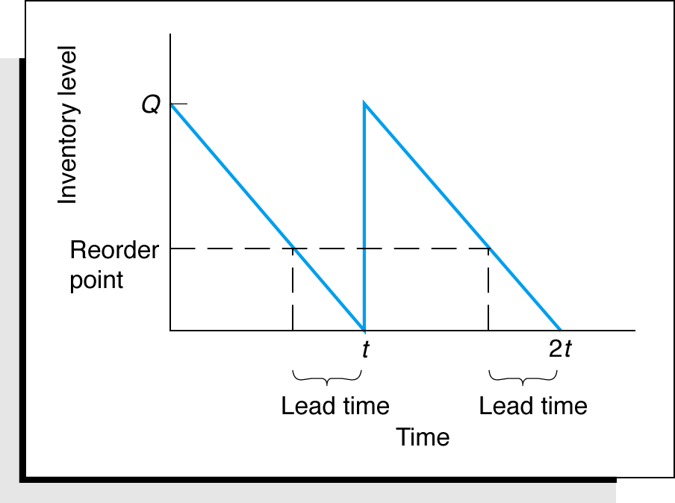
Reorder Point (2 of 4)
Figure 16.9 Reorder Point and Lead Time
Copyright © 2010 Pearson Education, Inc. Publishing as Prentice Hall

Slide 52
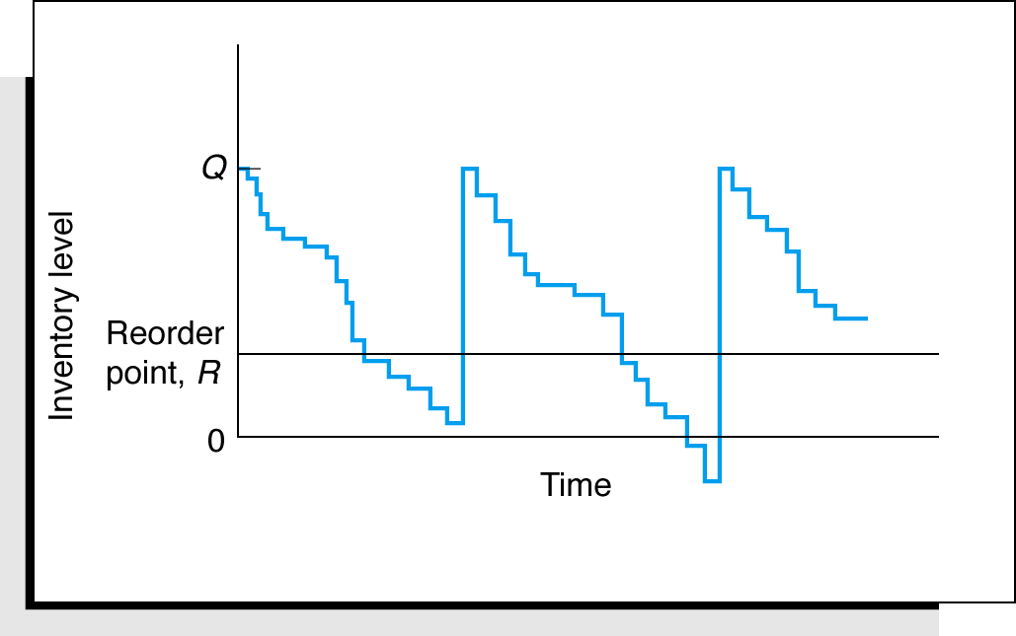
Reorder Point (3 of 4)
Inventory level might be depleted at slower or faster rate during lead time.
When demand is uncertain, safety stock is added as a hedge against stockout.
Figure 16.10 Inventory Model with Uncertain Demand
Copyright © 2010 Pearson Education, Inc. Publishing as Prentice Hall

Slide 53
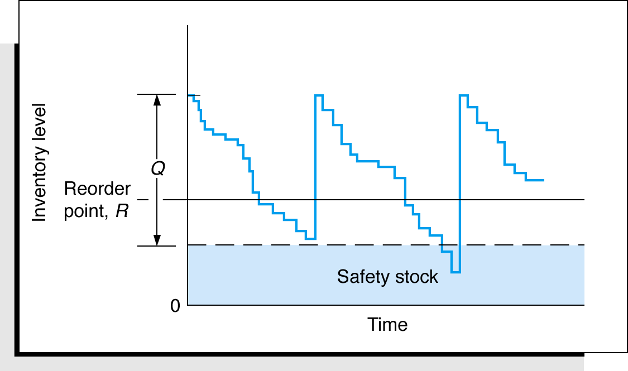
Reorder Point (4 of 4)
Figure 16.11 Inventory model with safety stock
Copyright © 2010 Pearson Education, Inc. Publishing as Prentice Hall

Slide 54
Determining Safety Stocks Using Service Levels
Service level is probability that amount of inventory on hand is sufficient to meet demand during lead time (probability stockout will not occur).
The higher the probability inventory will be on hand, the more likely customer demand will be met.
Service level of 90% means there is a .90 probability that demand will be met during lead time and .10 probability of a stockout.
Copyright © 2010 Pearson Education, Inc. Publishing as Prentice Hall

Slide 55
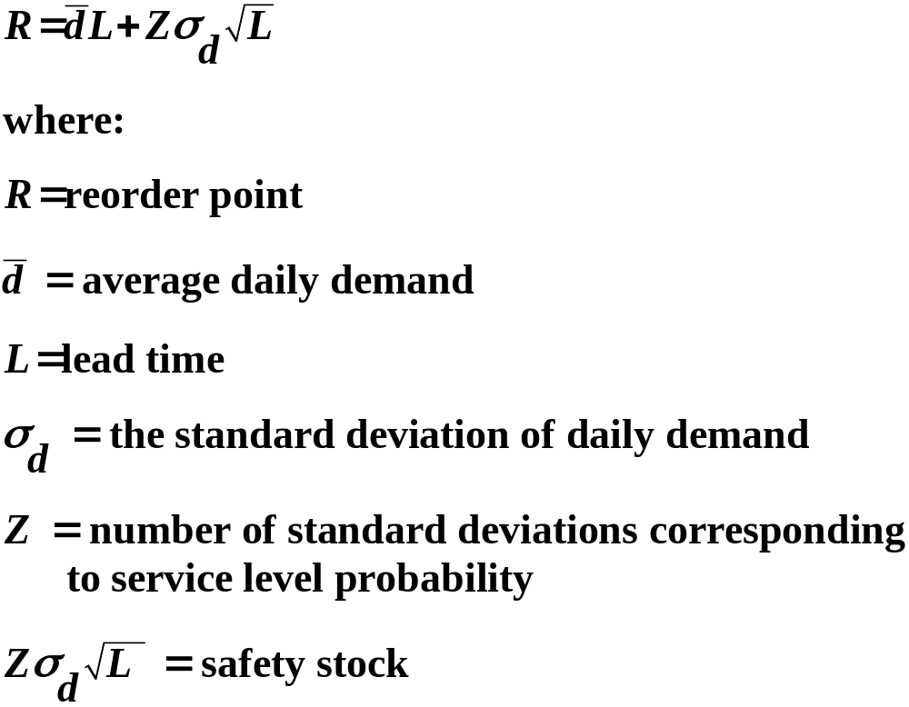
Reorder Point with Variable Demand (1 of 2)
Copyright © 2010 Pearson Education, Inc. Publishing as Prentice Hall

Slide 56
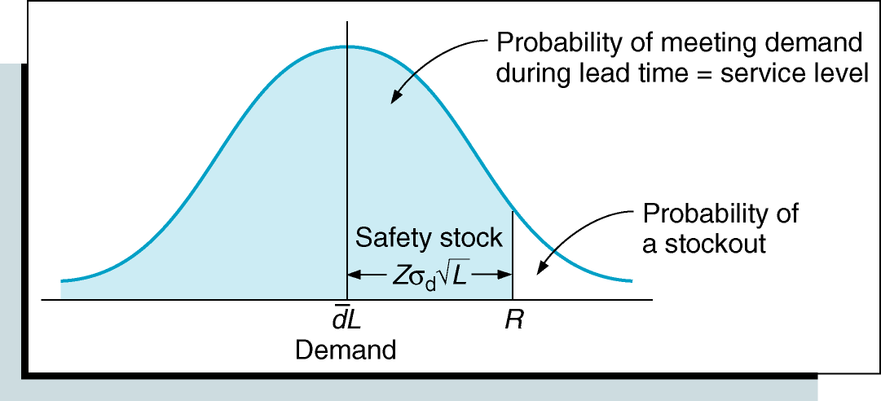
Reorder Point with Variable Demand (2 of 2)
Figure 16.12 Reorder Point for a Service Level
Copyright © 2010 Pearson Education, Inc. Publishing as Prentice Hall

Slide 57
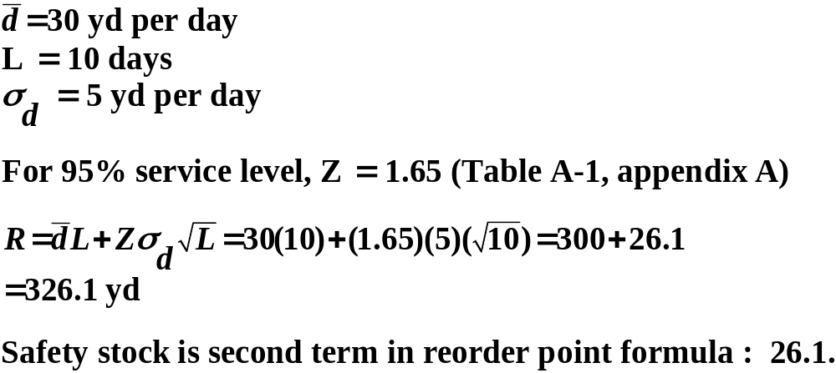
Reorder Point with Variable Demand Example
I-75 Carpet Discount Store Super Shag carpet.
For following data, determine reorder point and safety stock for service level of 95%.
Copyright © 2010 Pearson Education, Inc. Publishing as Prentice Hall

Slide 58
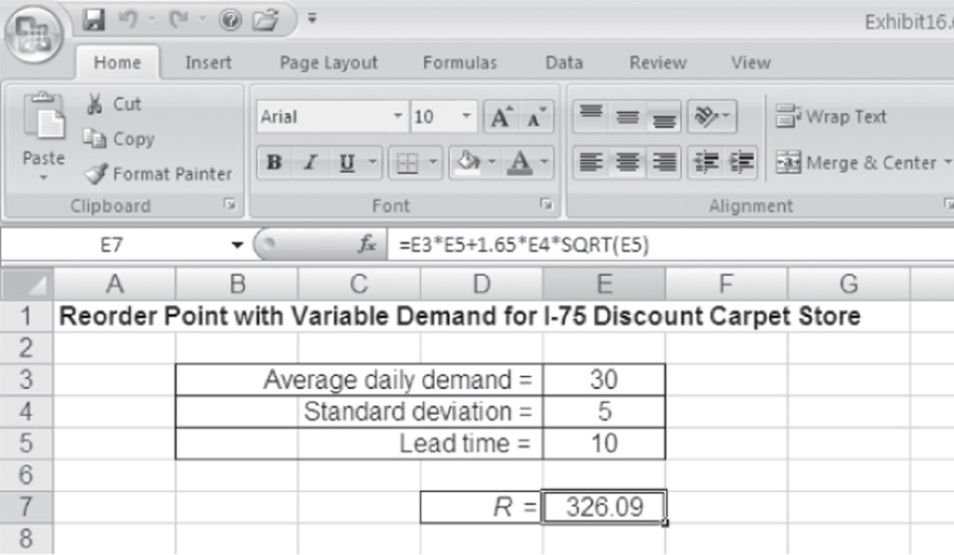
Determining Reorder Point with Excel
Exhibit 16.6
Copyright © 2010 Pearson Education, Inc. Publishing as Prentice Hall

Slide 59
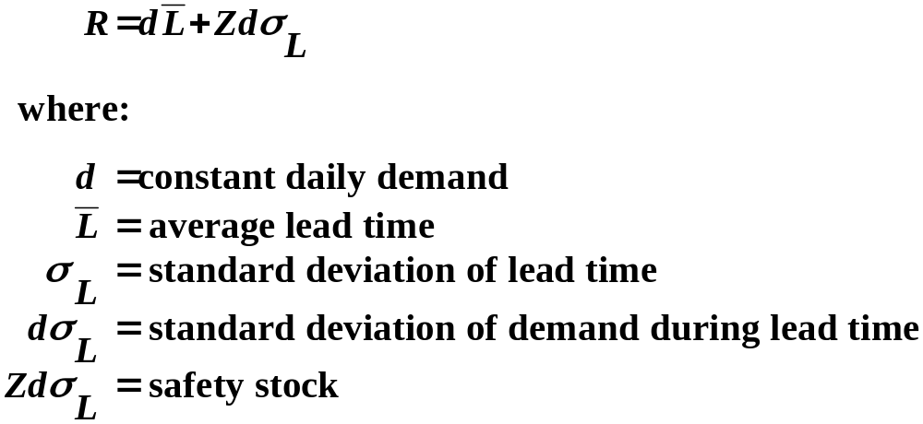
Reorder Point with Variable Lead Time
For constant demand and variable lead time:
Copyright © 2010 Pearson Education, Inc. Publishing as Prentice Hall

Slide 60
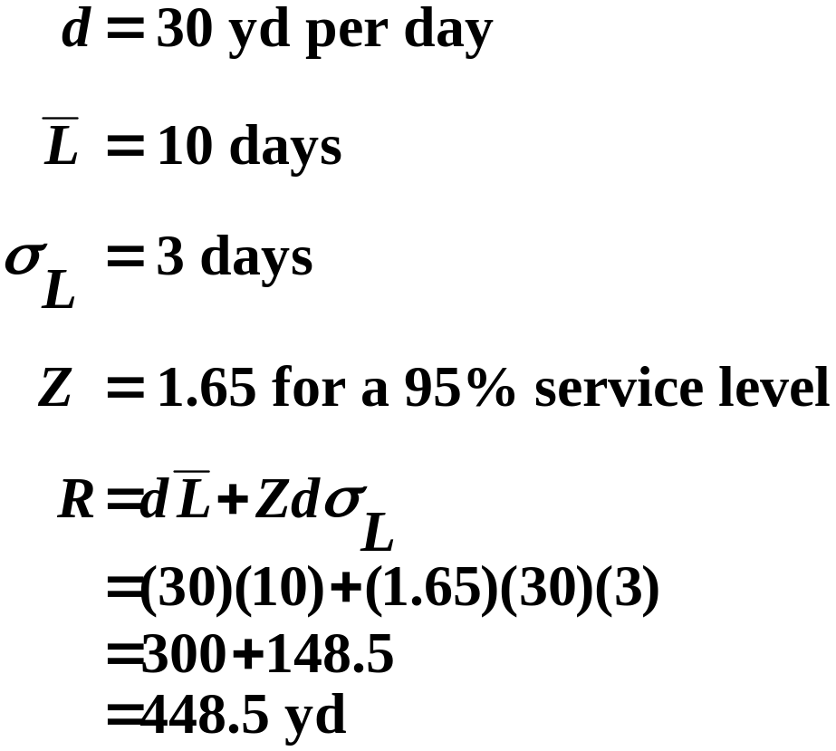
Reorder Point with Variable Lead Time Example
Carpet Discount Store:
Copyright © 2010 Pearson Education, Inc. Publishing as Prentice Hall

Slide 61
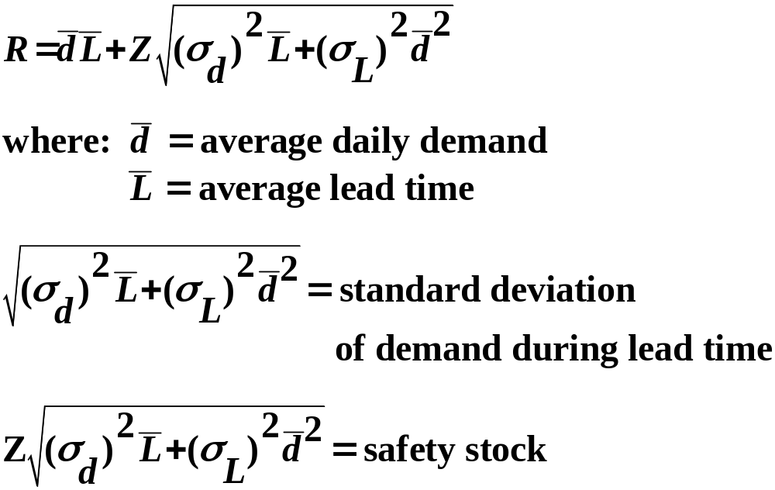
Reorder Point
Variable Demand and Lead Time
When both demand and lead time are variable:
Copyright © 2010 Pearson Education, Inc. Publishing as Prentice Hall

Slide 62
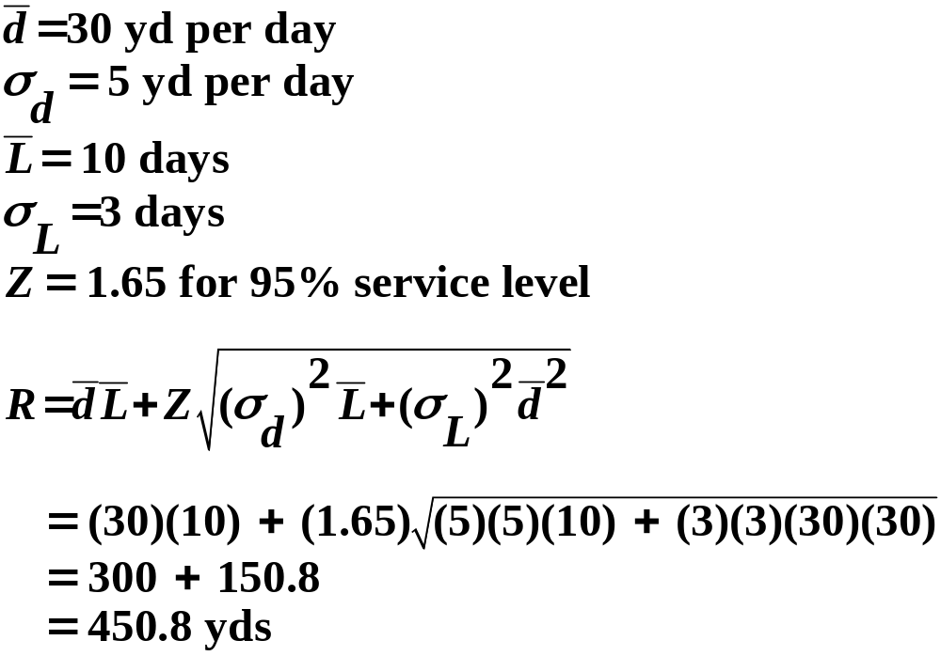
Reorder Point
Variable Demand and Lead Time Example
Carpet Discount Store:
Copyright © 2010 Pearson Education, Inc. Publishing as Prentice Hall

Slide 63
Order Quantity for a Periodic Inventory System
A periodic, or fixed-time period inventory system is one in which time between orders is constant and the order size varies.
Vendors make periodic visits, and stock of inventory is counted.
An order is placed, if necessary, to bring inventory level back up to some desired level.
Inventory not monitored between visits.
At times, inventory can be exhausted prior to the visit, resulting in a stockout.
Larger safety stocks are generally required for the periodic inventory system.
Copyright © 2010 Pearson Education, Inc. Publishing as Prentice Hall

Slide 64
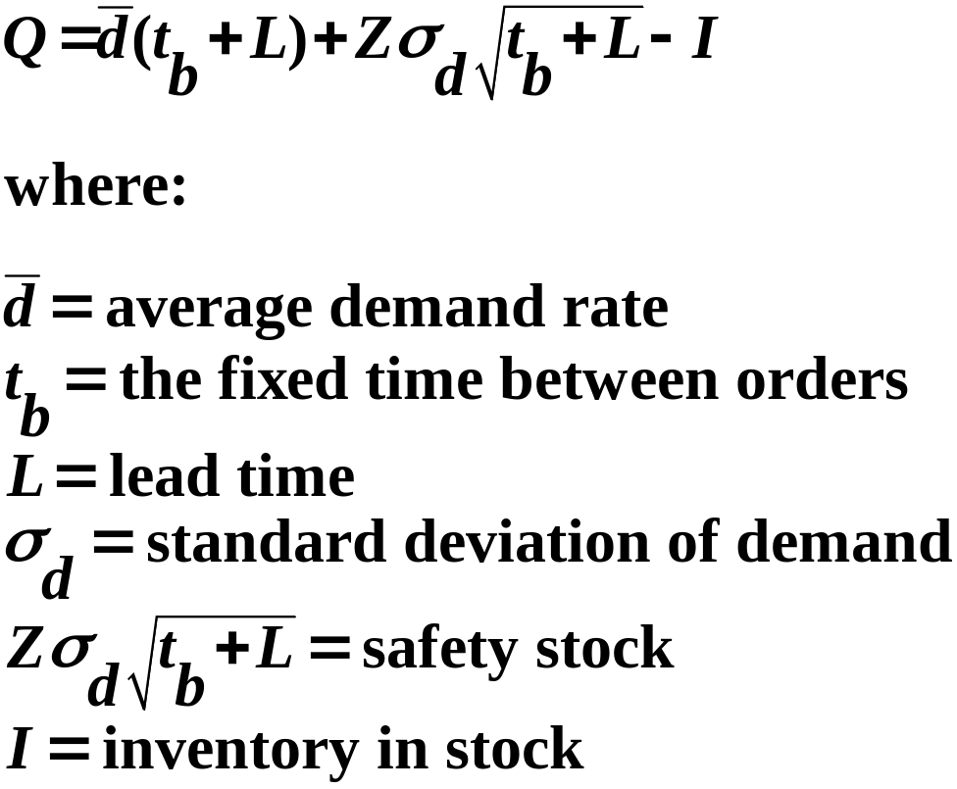
Order Quantity for Variable Demand
For normally distributed variable daily demand:
Copyright © 2010 Pearson Education, Inc. Publishing as Prentice Hall

Slide 65
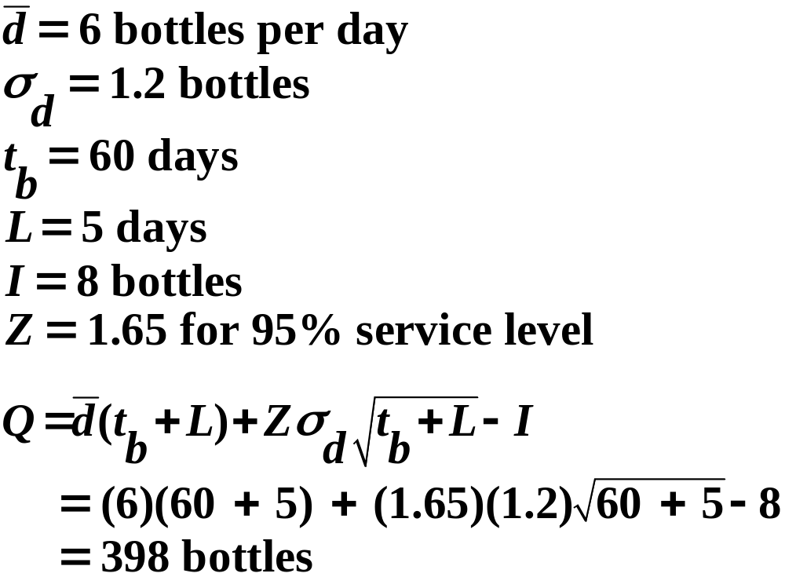
Order Quantity for Variable Demand Example
Corner Drug Store with periodic inventory system.
Order size to maintain 95% service level:
Copyright © 2010 Pearson Education, Inc. Publishing as Prentice Hall

Slide 66
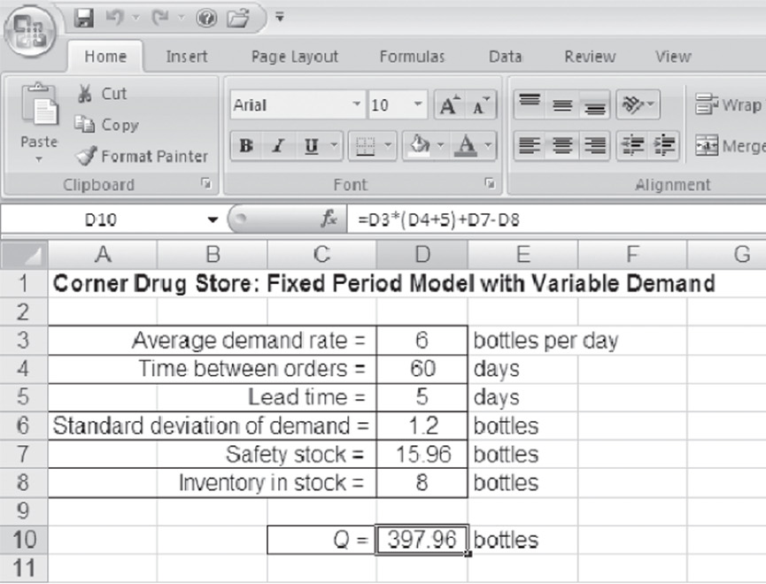
Order Quantity for the Fixed-Period Model
Solution with Excel
Exhibit 16.7
Copyright © 2010 Pearson Education, Inc. Publishing as Prentice Hall

Slide 67
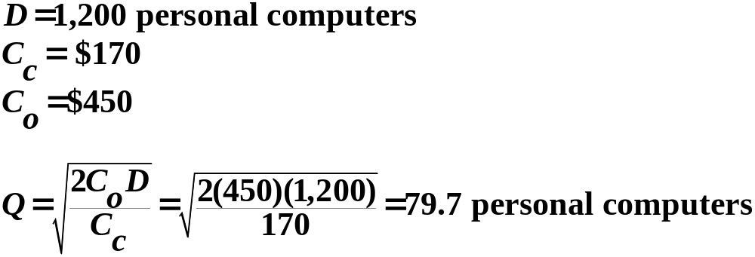
Example Problem Solution
Electronic Village Store (1 of 3)
For data below determine:
  Optimal order quantity and total minimum inventory cost.
  Assume shortage cost of $600 per unit per year, compute optimal order quantity and minimum inventory cost.
Step 1 (part a): Determine the Optimal Order Quantity.
Copyright © 2010 Pearson Education, Inc. Publishing as Prentice Hall

Slide 68
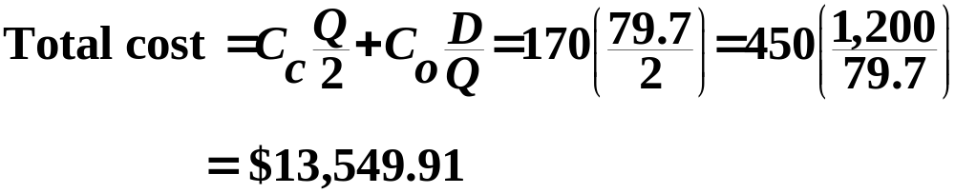

Example Problem Solution
Electronic Village Store (2 of 3)
Step 2 (part b): Compute the EOQ with Shortages.
Copyright © 2010 Pearson Education, Inc. Publishing as Prentice Hall

Slide 69

Example Problem Solution
Electronic Village Store (3 of 3)
Copyright © 2010 Pearson Education, Inc. Publishing as Prentice Hall

Slide 70

Example Problem Solution
Computer Products Store (1 of 2)
Sells monitors with daily demand normally distributed with a mean of 1.6 monitors and standard deviation of 0.4 monitors. Lead time for delivery from supplier is 15 days.
Determine the reorder point to achieve a 98% service level.
Step 1: Identify parameters.
Copyright © 2010 Pearson Education, Inc. Publishing as Prentice Hall

Slide 71

Example Problem Solution
Computer Products Store (2 of 2)
Step 2: Solve for R.
Copyright © 2010 Pearson Education, Inc. Publishing as Prentice Hall

Slide 72

Copyright © 2010 Pearson Education, Inc. Publishing as Prentice Hall

